Slide 1





Bayesian Graphical Modeling
Topological Priors
What is psychometrics? 2025
m.marsman@uva.nl
bayesiangraphicalmodeling.com

Slide 2




Session setup
Part I: Theory
Part II: Tutorial / Practical
image: Flaticon.com

Slide 3
Session setup
Part I: Theory
image: Flaticon.com

Slide 4
Whats the evidence?
Contrary to most existing network estimation methods, the Bayes factor analyses in Session I allowed us to quantify evidence of absence, not just detect absence of evidence.
This naturally raises a question: What happens when we apply this Bayesian reasoning to existing, published networks?
To explore this, we performed a Bayesian reanalysis of previously reported networks.
Huth, K., Haslbeck, J., Keetelaar, S., van Holst, R., & Marsman, M. (in press). Statistical evidence in psychological networks: A Bayesian analysis of 294 networks from 126 studies. Nature Human Behavior.

Slide 5
Papers and data

Slide 6
Papers and data
Robinaugh et al. (2018): 732 papers published between 2008 and 2018 on networks / 363 papers on psychiatric phenomena including a network approach
Screening 4,720 papers
3,333 excluded
1,387 included (+ 36 additions)

Slide 7
Papers and data
No empirical analyses
No cross-sectional analyses
No psychometric variables
Screening 4,720 papers
3,333 excluded
1,387 included (+ 36 additions)

Slide 8
Papers and data
Screening 4,720 papers
3,333 excluded
1,387 included (+ 36 additions)
Inquired 1,423 datasets
443 responses
126 included
317 excluded
→ 126 papers; 293 networks

Slide 9
Papers and data
Screening 4,720 papers
3,333 excluded
1,387 included (+ 36 additions)
Inquired 1,423 datasets
443 responses
126 included
317 excluded
→ 126 papers; 293 networks

Slide 10
Analysis
We analyzed all networks using the Gaussian graphical model
For each network relation, we use the Bayes factor to assess the support in the data for the competing hypotheses:

Slide 11
Analysis
The Bayes factor indicates how much more plausible the data are under one hypothesis relative to the other

Slide 12
Analysis
The Bayes factor indicates how much more plausible the data are under one hypothesis relative to the other

Slide 13
Analysis
The Bayes factor indicates how much more plausible the data are under one hypothesis relative to the other

Slide 14
Analysis
The Bayes factor indicates how much more plausible the data are under one hypothesis relative to the other

Slide 15
Results

Slide 16
Results

Slide 17
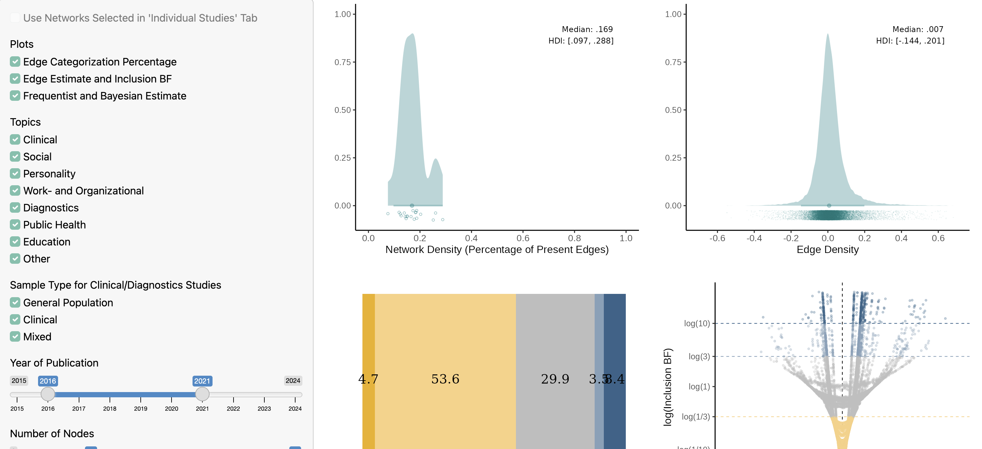
Results
https://uvasobe.shinyapps.io/ReBayesed/

Slide 18
Conclusions
Strong evidence for the presence or absence of ~20% edges
BF₁₀ < 1/10 or 10 < BF₁₀
Huth, K., Haslbeck, J., Keetelaar, S., van Holst, R., & Marsman, M. (in press). Statistical evidence in psychological networks: A Bayesian analysis of 294 networks from 126 studies. Nature Human Behavior.

Slide 19
Conclusions
Strong evidence for the presence or absence of ~20% edges
BF₁₀ < 1/10 or 10 < BF₁₀
Weak evidence for the presence or absence of ~50% edges
1/10 < BF₁₀ < 1/3 or 3 < BF₁₀ < 10
Huth, K., Haslbeck, J., Keetelaar, S., van Holst, R., & Marsman, M. (in press). Statistical evidence in psychological networks: A Bayesian analysis of 294 networks from 126 studies. Nature Human Behavior.

Slide 20
Conclusions
Strong evidence for the presence or absence of ~20% edges
BF₁₀ < 1/10 or 10 < BF₁₀
Weak evidence for the presence or absence of ~50% edges
1/10 < BF₁₀ < 1/3 or 3 < BF₁₀ < 10
Inconclusive evidence of remaining ~30% of edges
1/3 < BF₁₀ < 3
Huth, K., Haslbeck, J., Keetelaar, S., van Holst, R., & Marsman, M. (in press). Statistical evidence in psychological networks: A Bayesian analysis of 294 networks from 126 studies. Nature Human Behavior.

Slide 21
Conclusions
Strong evidence for the presence or absence of ~20% edges
BF₁₀ < 1/10 or 10 < BF₁₀
Weak evidence for the presence or absence of ~50% edges
1/10 < BF₁₀ < 1/3 or 3 < BF₁₀ < 10
Inconclusive evidence of remaining ~30% of edges
1/3 < BF₁₀ < 3
Strength of evidence strongly determined by (relative) sample size
Median was 5 obs. per edge (1 <, > 7,000).
Huth, K., Haslbeck, J., Keetelaar, S., van Holst, R., & Marsman, M. (in press). Statistical evidence in psychological networks: A Bayesian analysis of 294 networks from 126 studies. Nature Human Behavior.

Slide 22
Limitations
We applied a single-model Bayes Factor and GGM to all data
Huth, K., Haslbeck, J., Keetelaar, S., van Holst, R., & Marsman, M. (in press). Statistical evidence in psychological networks: A Bayesian analysis of 294 networks from 126 studies. Nature Human Behavior.

Slide 23
Limitations
We applied a single-model BF and GGM to all data
We used arbitrary evidence thresholds
Huth, K., Haslbeck, J., Keetelaar, S., van Holst, R., & Marsman, M. (in press). Statistical evidence in psychological networks: A Bayesian analysis of 294 networks from 126 studies. Nature Human Behavior.

Slide 24
Limitations
We applied a single-model BF and GGM to all data
We used arbitrary evidence thresholds
Unclear generalizability to ”the field”
30% response rate
exclusion criteria
Huth, K., Haslbeck, J., Keetelaar, S., van Holst, R., & Marsman, M. (in press). Statistical evidence in psychological networks: A Bayesian analysis of 294 networks from 126 studies. Nature Human Behavior.

Slide 25
Limitations
We applied a single-model BF and GGM to all data
We used arbitrary evidence thresholds
Unclear generalizability to ”the field”
30% response rate
exclusion criteria
We did not compare to original conclusions
→ Might have indicated uncertainty
→ Might not have been interested in the structure/edges
Huth, K., Haslbeck, J., Keetelaar, S., van Holst, R., & Marsman, M. (in press). Statistical evidence in psychological networks: A Bayesian analysis of 294 networks from 126 studies. Nature Human Behavior.

Slide 26
What did the reanalysis reveal?
Bayes factors for most edges were small → evidence for inclusion or exclusion often inconclusive
As a result, there is considerable uncertainty about the overall network structure
Our Bayes factor methods ignored multiplicity → overstate confidence in individual edges
Together, this shows the need to model structural uncertainty explicitly
Sekulovski, N., Keetelaar, S., Huth, K., Wagenmakers, E.-J., van Bork, R., van den Bergh, D., & Marsman, M. (2024). Testing Conditional Independence in Psychometric Networks: An Analysis of Three Bayesian Methods. Multivariate Behavioral Research, 59, 913-933.

Slide 27
Existing models/priors for network structures
The independent Bernoulli model
Here, k is number of active edges, m total number of edges. But what is the inclusion probability?
Marsman, M., Huth, K., Waldorp, L., & Ntzoufras, I. (2022). Objective Bayesian Edge Screening and Structure Selection for Ising Networks. Psychometrika, 87, 47-82.
Mohammadi, R., & Wit, E. (2019). BDgraph: An R Package for Bayesian Structure Learning in Graphical Models. Journal of Statistical Software, 89, 1–30.

Slide 28
Existing models/priors for network structures
The Beta-Bernoulli model
Here, k is number of active edges, m total number of edges.
Marsman, M., Huth, K., Waldorp, L., & Ntzoufras, I. (2022). Objective Bayesian Edge Screening and Structure Selection for Ising Networks. Psychometrika, 87, 47-82.

Slide 29
Existing models/priors for network structures
Marsman, M., Huth, K., Waldorp, L., & Ntzoufras, I. (2022). Objective Bayesian Edge Screening and Structure Selection for Ising Networks. Psychometrika, 87, 47-82.

Slide 30
Existing models/priors for network structures
Marsman, M., Huth, K., Waldorp, L., & Ntzoufras, I. (2022). Objective Bayesian Edge Screening and Structure Selection for Ising Networks. Psychometrika, 87, 47-82.

Slide 31
Existing models/priors for network structures
Marsman, M., Huth, K., Waldorp, L., & Ntzoufras, I. (2022). Objective Bayesian Edge Screening and Structure Selection for Ising Networks. Psychometrika, 87, 47-82.

Slide 32
Existing models/priors for network structures
The Stochastic-Block model
Here, z are cluster allocations, m total number of clusters (blocks).
Sekulovski, N., Arena, G., Mr., Haslbeck, J., Huth, K., Friel, N., & Marsman, M. (2025). A Stochastic Block Prior for Clustering in Graphical Models. Preprint: doi: 10.31234/osf.io/29p3m_v1

Slide 33
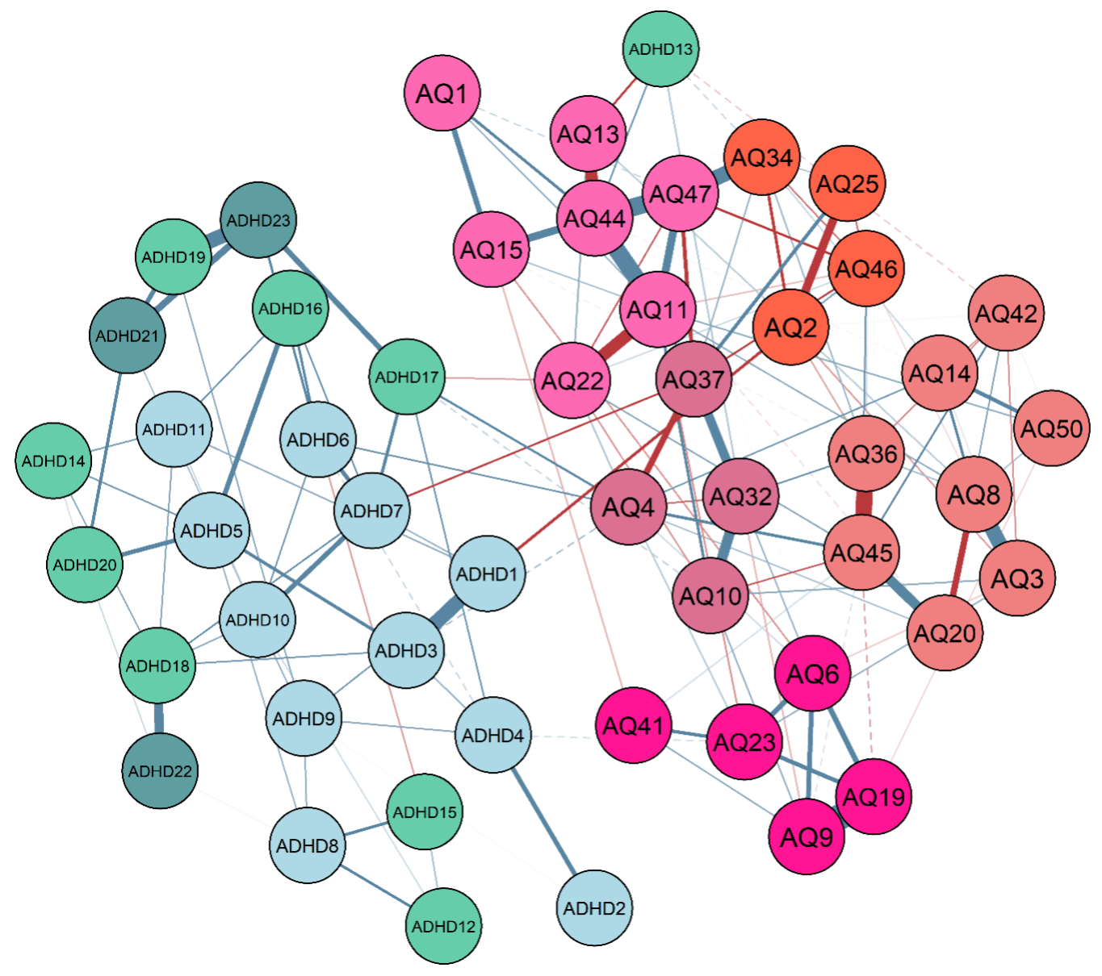
Existing models/priors for network structures
Sekulovski, N., Arena, G., Mr., Haslbeck, J., Huth, K., Friel, N., & Marsman, M. (2025). A Stochastic Block Prior for Clustering in Graphical Models. Preprint: doi: 10.31234/osf.io/29p3m_v1

Slide 34
From edge evidence to topological priors
Why this matters
Network structures show large uncertainty.
Existing (Bayesian) methods ignore multiplicity.
We need to model uncertainty at the structural level.
What we will do in the tutorial
Learn how to represent beliefs about topology using priors.
See how priors provide automatic multiplicity correction.
Explore three key priors: – Bernoulli → overall density – Beta–Bernoulli → balanced complexity – Stochastic Block Model (SBM) → clustering & domains

Slide 35
Session setup
Part II: Tutorial / Practical
image: Flaticon.com

